Slide 1
NAKUJA 4 Solid Propulsion Team
WEEK 4 PROGRESS REPORT

Slide 2
WEEK’S OBJECTIVES
Preparation of the Bill of Materials #1
Procurement of Materials #1
3D Printing of the Casting Tools #2
Research on Test Stand Design #5
Research on Motor Inhibitor #6

Slide 3
PREPARATION OF BILL OF MATERIALS
We prepared the bill of materials which included;
materials needed for fabrication of the motor and nozzle and casing
ignition circuit components
chemicals required for grain preparation and storage
The following is the link for the Bill of Materials
https://docs.google.com/spreadsheets/d/1FbWmaaT0nI9665jFh08SqWUDMGrxwWAyC85VwriNi-A/edit?usp=sharing

Slide 4
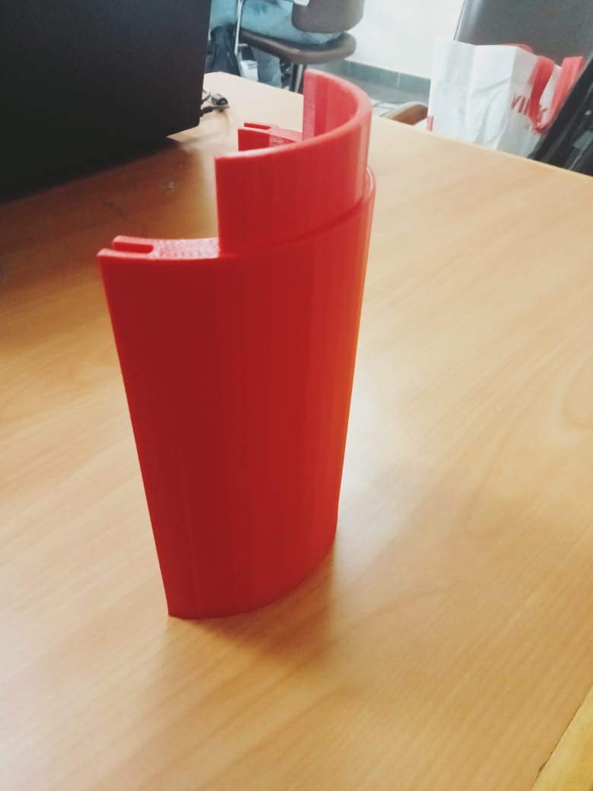
3D PRINTING OF THE CASTING TOOLS
We modified the infill and design of the casting tools to 70%.
This was to make them strong enough to handle the weight and temperature of the grains.
The weight of a single grain being about 1.26 kg.

Slide 5
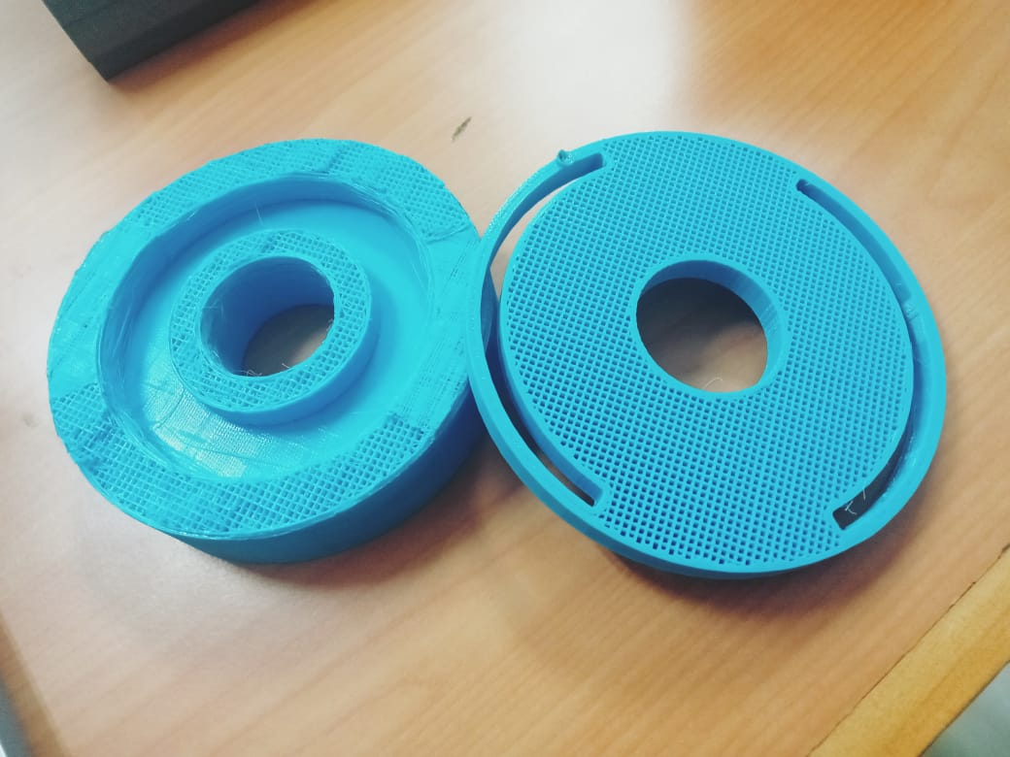
CHALLENGES ENCOUNTERED DURING 3D PRINTING
During printing of the base, the 3D printer failed a few times.
This was due to;
Use of a newer Prusa Slicing Software that wasn’t exactly compatible with the Prusa i3 3D Printer
Not including supports during printing
There was an issue with transfer of the sliced files to the Ultimaker Cura S3 printer
We were able to diagnose and rectify the above issues.

Slide 6
THERMAL INSULATION OF ALUMINIUM CASING
. During combustion, the propellant generates intense heat (approx. 1600K)
. Without insulation, this heat would cause structural failure.
Factors to consider: Material Selection, Thickness Optimization, Adhesion and Bonding
Challenge: Thickness Optimization
Material used
Ceramic Cloth: a high-temperature ceramic cloth 1260°C. Serves as the ablative layer, shielding the motor case from direct heat transfer.
Epoxy Resin Sealing: To secure the ceramic cloth, we use thermosetting epoxy resin. This prevents leakage.

Slide 7
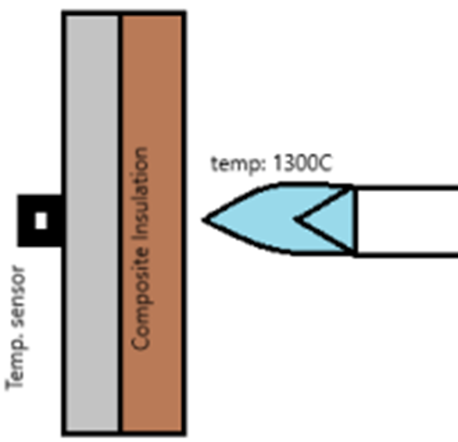
INSULATION CONT.
Critical Sealing:—the bulkhead and nozzle—we rely on heat-resistant silicon (ceramic silicon).
Rating: 1500°C
Optimization and Practical Factors
Insulation Thickness: By experimental means
Use of oxy-acetylene neutral flame
To investigate ablation rate and casing temp

Slide 8
NEXT WEEK’S OBJECTIVES
Fabrication of Casing and Bulkhead
Cooking of Grains Continuation
Test Stand Fabrication
Ignition Circuit Fabrication

Slide 9
THANK YOU

